Slide 1
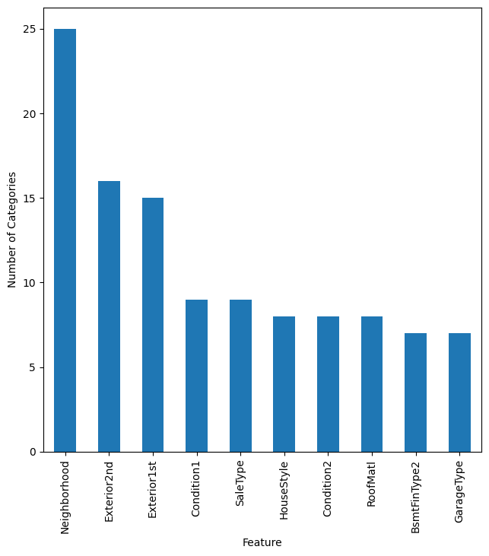
Features with most Categories
There are a lot of Neighborhoods to deal with. We expect that information will be important for differentiating house prices. The rest look to have a manageable number of categories.

Slide 2
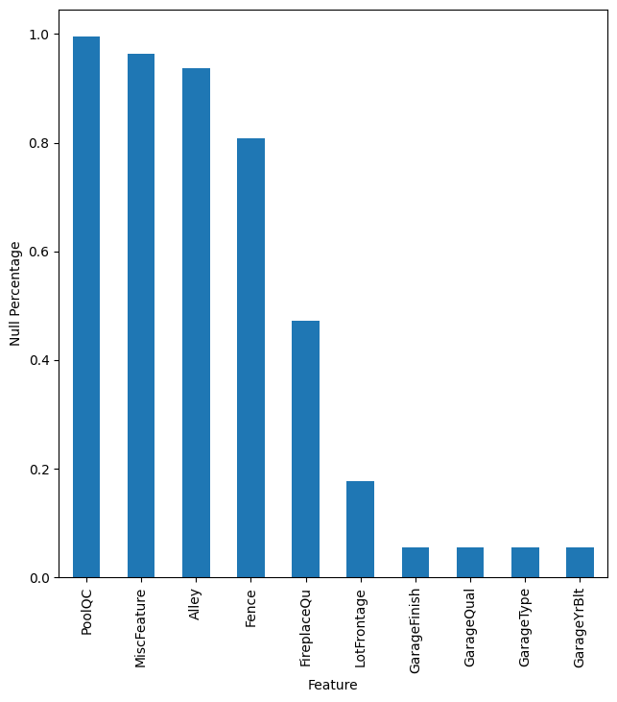
Null percentage
We get an idea of the percentage of null values in each feature. Pool, MiscFeature, and Alley are almost entirely null. Fence is largely null, but that could still be useful as it just means most don't have a fence. Same with fireplace quality. The others would need to be imputed.

Slide 3
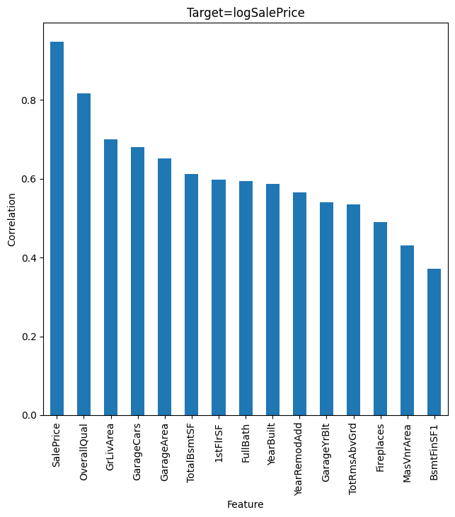
Correlation against LogSalePrice
We want to minimize the least squares error for the log fo the saleprice. Also, there are many categories that could be encoded, so we first work through the categories so they will show up in the correlations.

Slide 4
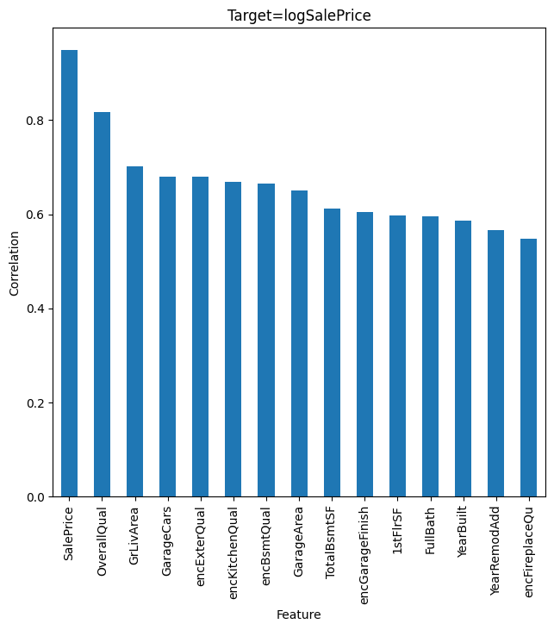
Correlations with Encodings
Went through categorical features and added encoding for all features that could be ordered.

Slide 5
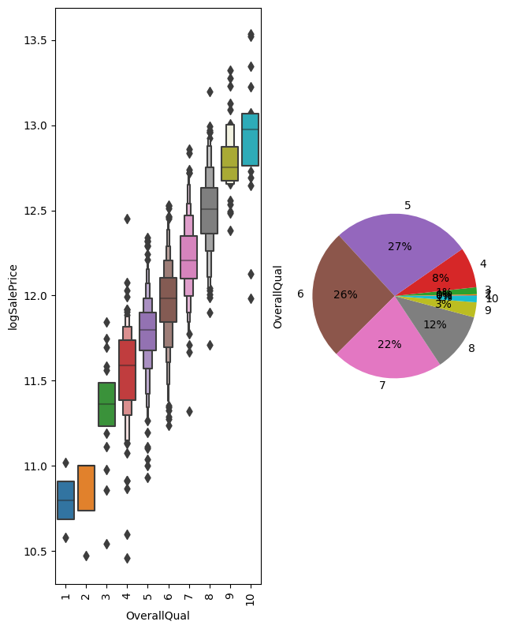
OverallQual
Clear trend.

Slide 6
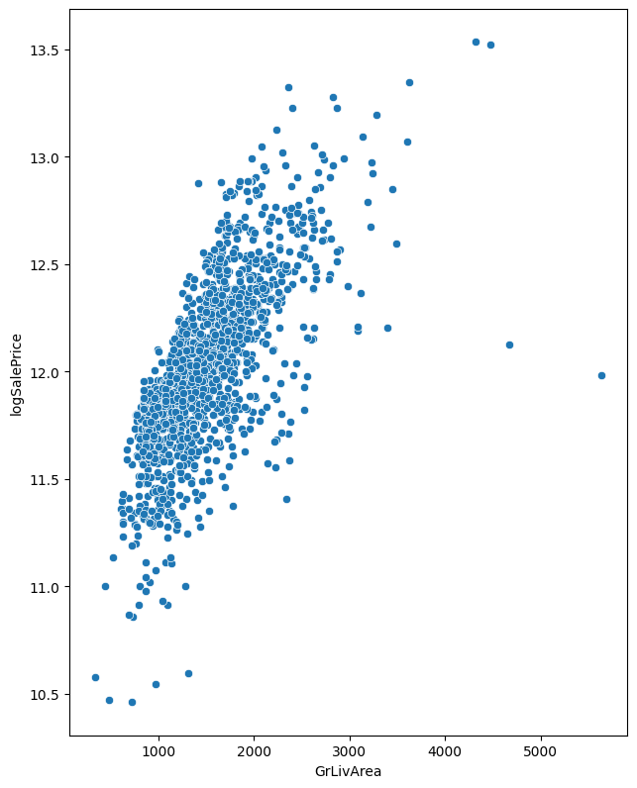
Living Area
Has some outliers. We can clip the range and try log transform.

Slide 7
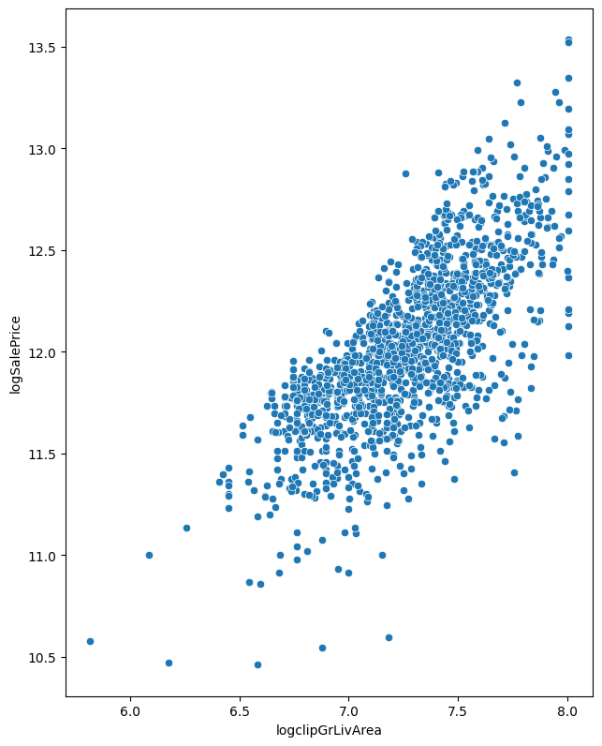
Log and Clip
Improved correlation slightly.

Slide 8
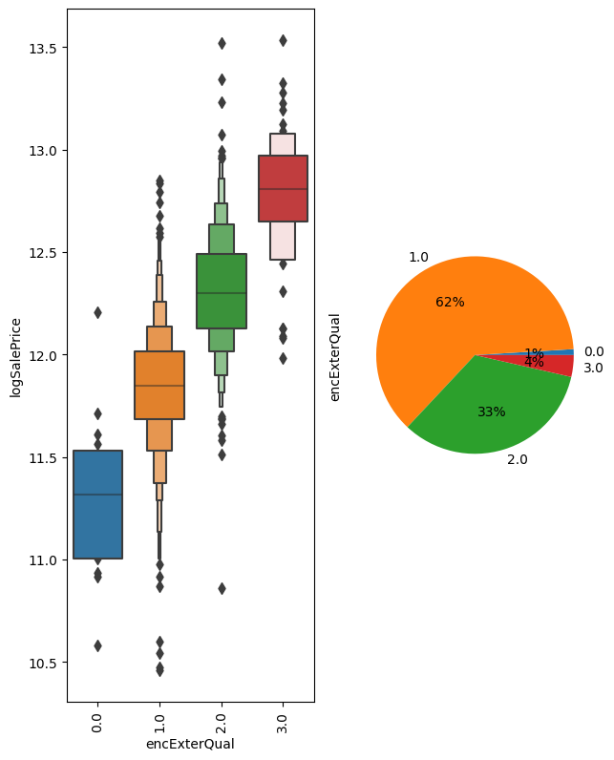
External Quality
Good correlation.

Slide 9
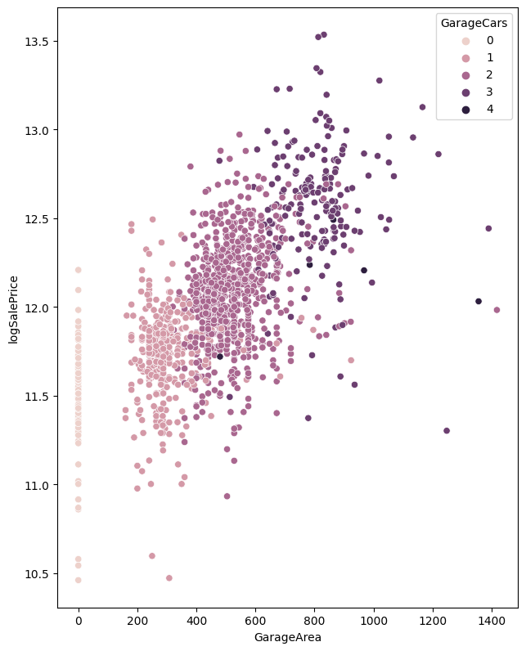
Garage Size
Clear correlation between number of cars and garage area. Might be redundant to use both.

Slide 10
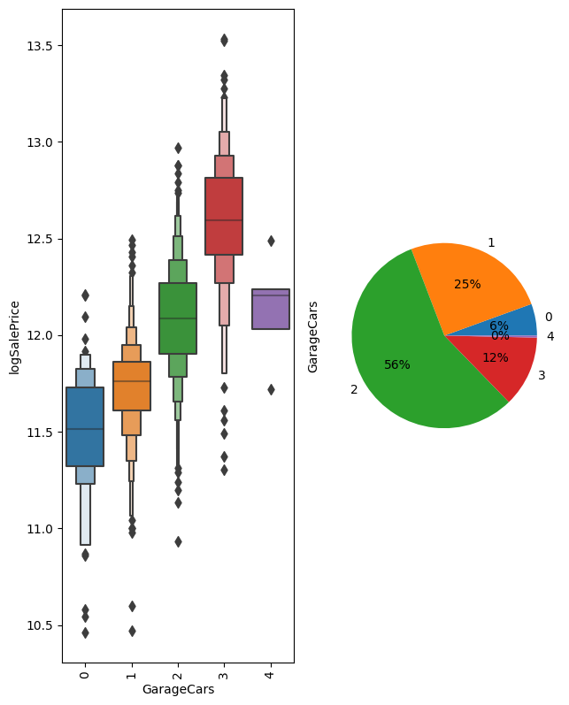
GarageCars
Strong Correlation. Simpler to see than scatter plot.

Slide 11
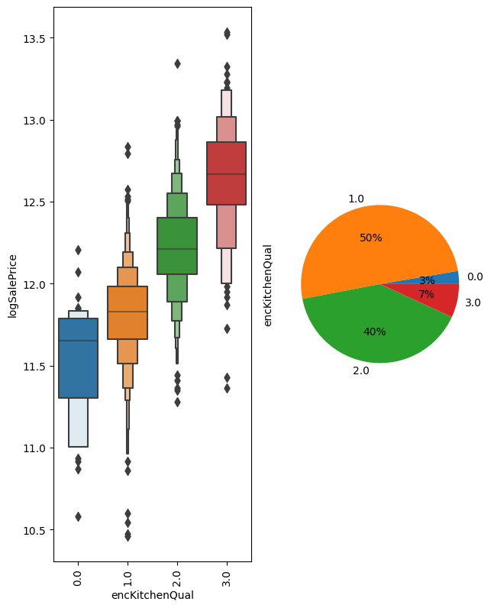
KitchenQual
Strong correlation.

Slide 12
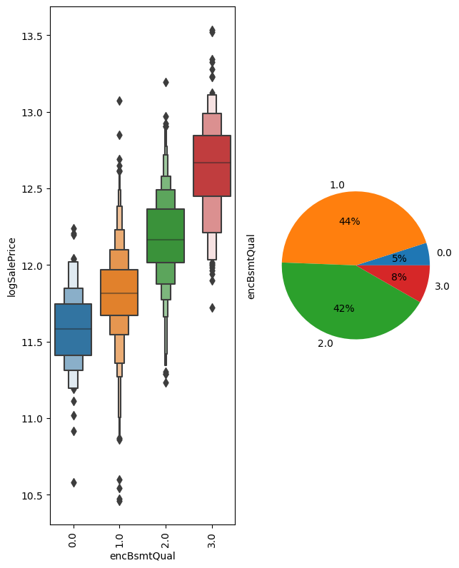
BsmtQual
Strong Correlation.

Slide 13
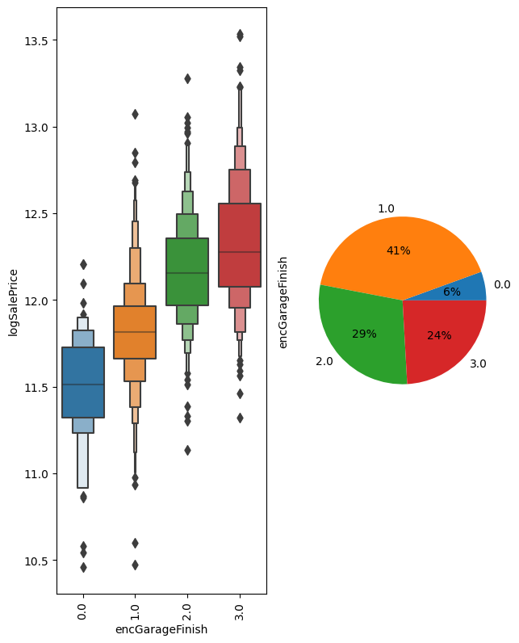
Garage Finish
Pretty strong correlation

Slide 14
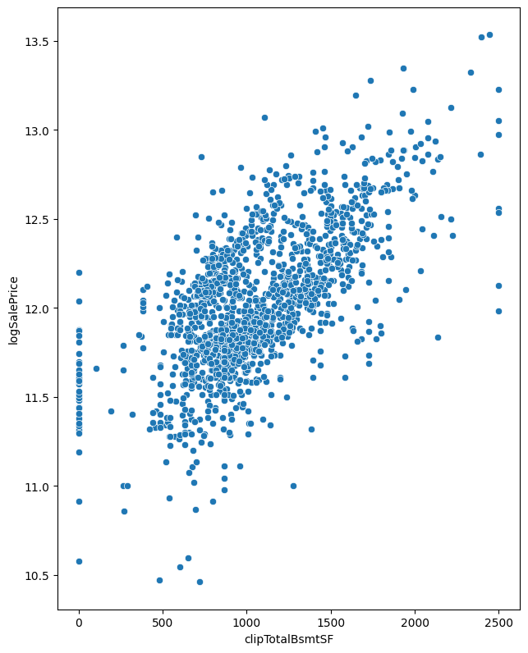
TotalBsmtSF
Better correlation when outliers are clipped.

Slide 15
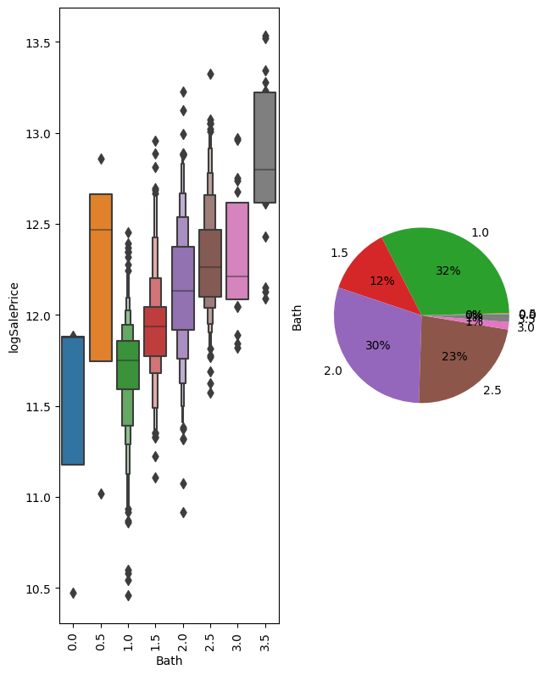
Bath
Good correlation for the large categories.

Slide 16
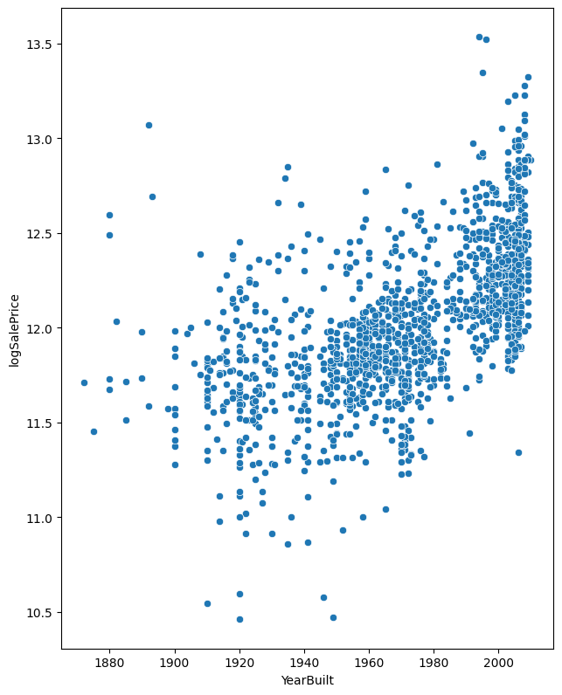
Year Built
Nonlinear since data is mostly flat before 1950. There is actually a higher correlation with YearRemodAdd which is very similar but has lower limit at 1950.

Slide 17
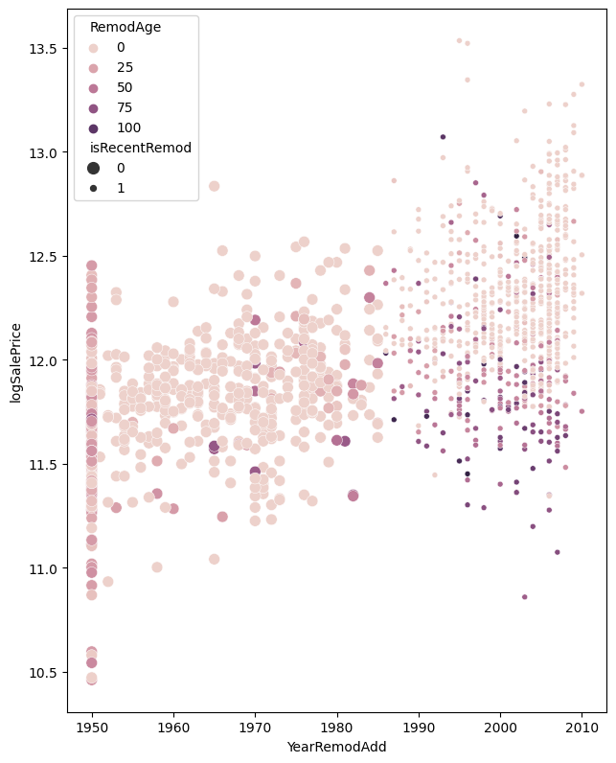
Remodels
We see that the age of the house when the remodel occurs seems to matter most for recent remodels.

